Slide 1
Digital Image : How To Capture Images
Chul Min Yeum
Assistant Professor
Civil and Environmental Engineering
University of Waterloo, Canada
CIVE 497 – CIVE 700: Smart Structure Technology
Last updated: 2018-01-28

Slide 2
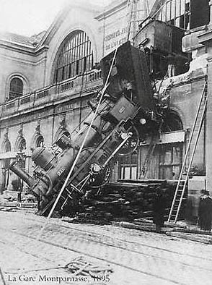
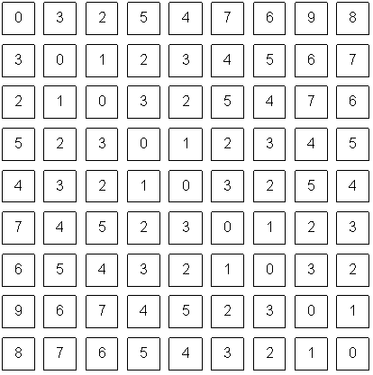
Real-World Scenes and Digital Images
Camera
Image processing
Computer Vision
What we see
What a computer sees
Notes:
Inverse Optics
Intelligent interpretation of Imagery
Building a Visual Cortex

Slide 3
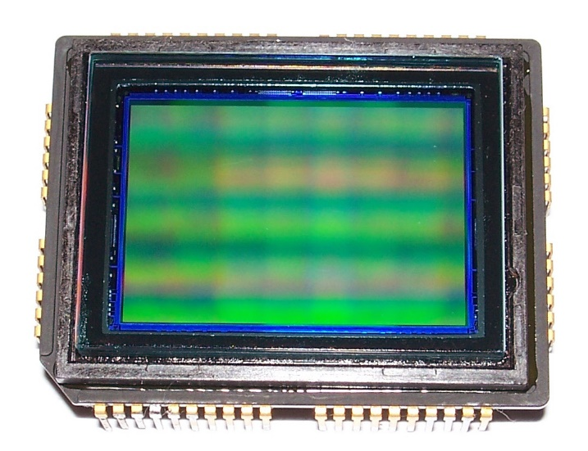

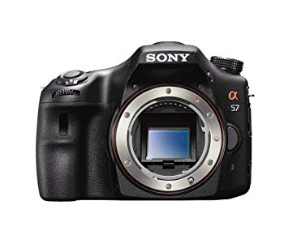
What is the Pixel?
Image sensor
DSLR camera

Slide 4
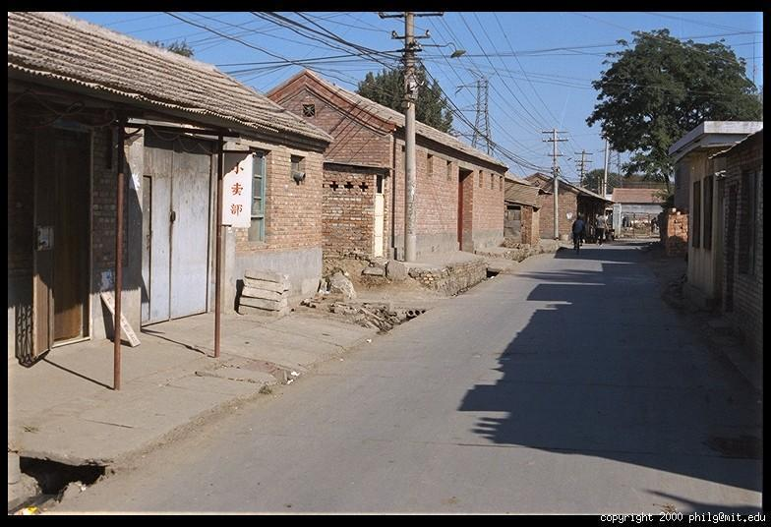
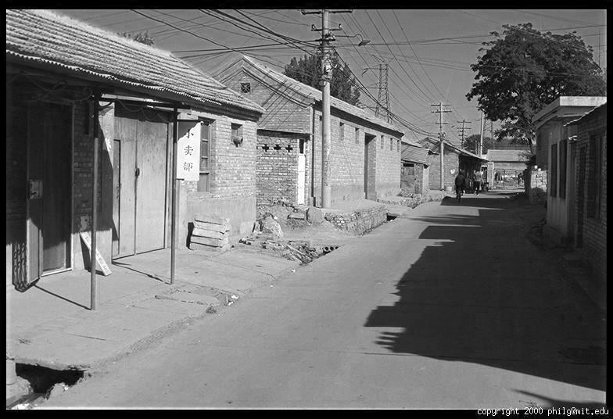
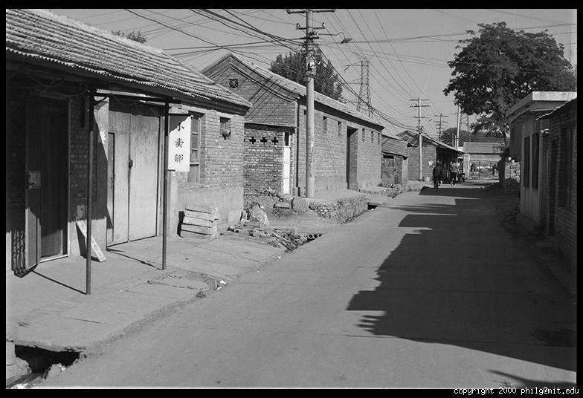
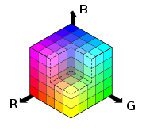
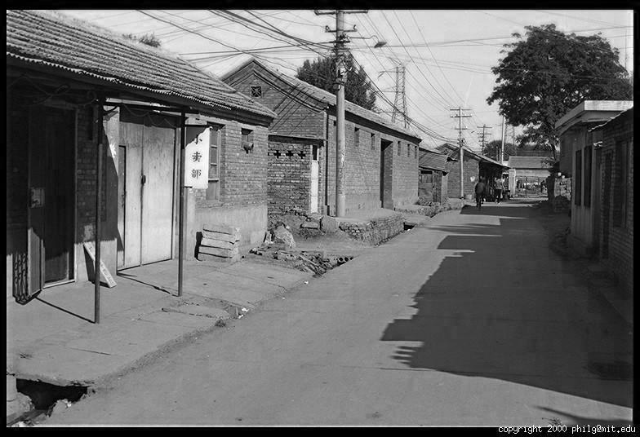
Color Images
R
G
B

Slide 5
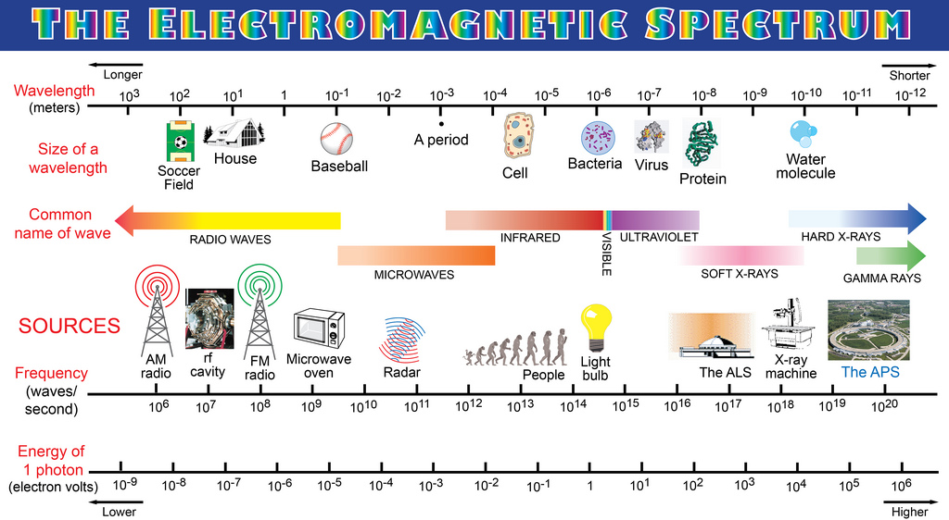
Visible Light Spectrum

Slide 6
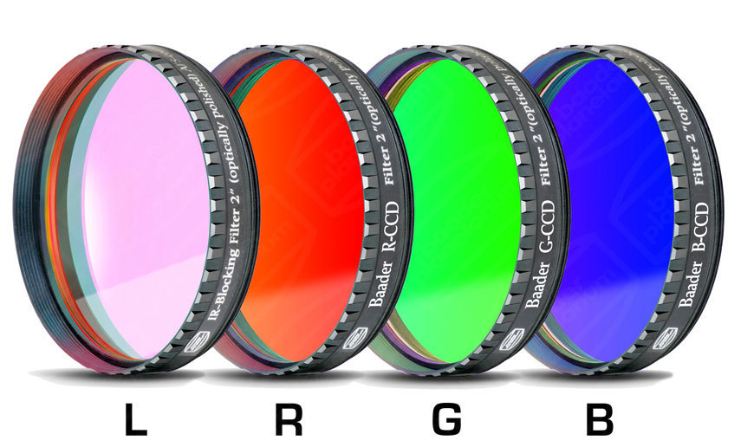
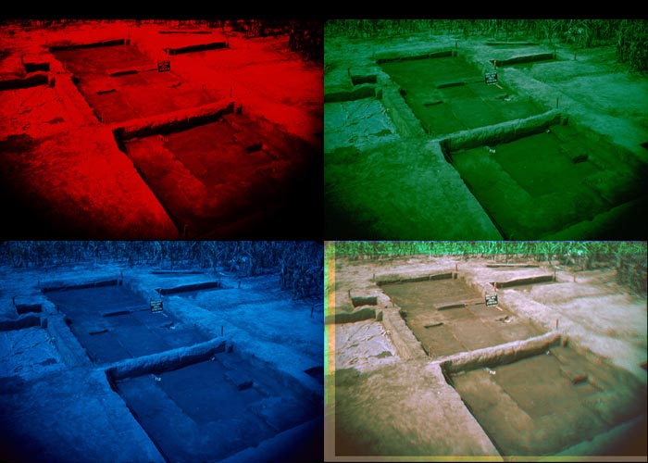
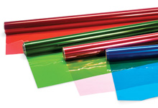
RGB Filter
https://www.photo.net/discuss/threads/rgb-filters-for-color-w-b-w-film.414924/
https://tienda.lunatico.es/RGBUV/IR-Baader-2-filter-set

Slide 7
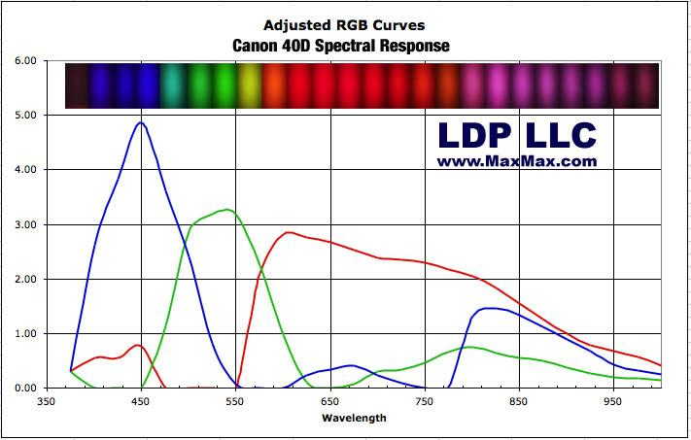
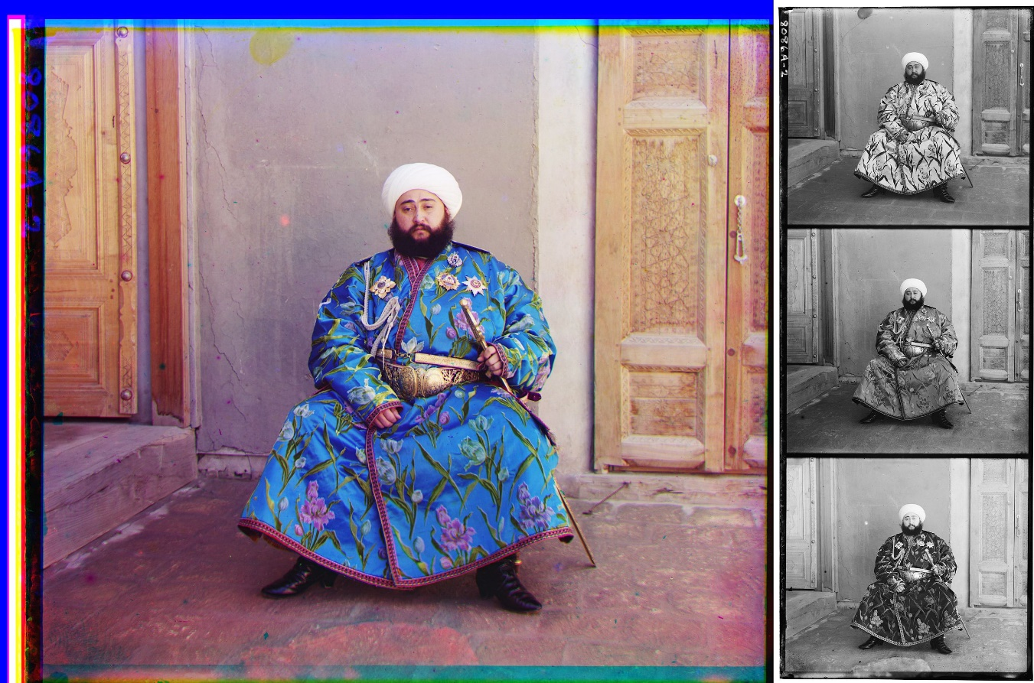
Spectral Response
https://en.wikipedia.org/wiki/RGB_color_model#/media/File:Rgb-compose-Alim_Khan.jpg
https://maxmax.com/spectral_response.htm

Slide 8
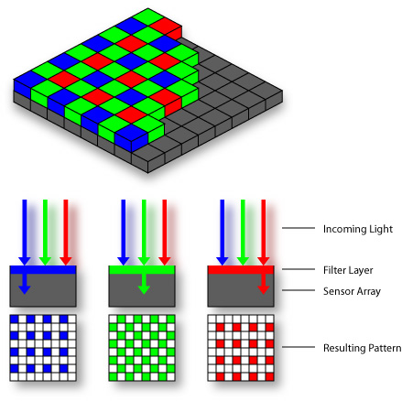

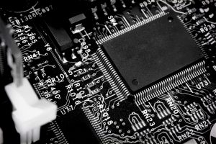
Color Filter Arrays
Bayer grid
Demosaicing:
Estimation of missing components from neighboring values
Monochrome machine vision camera

Slide 9
Image File Structure
Images represented as a matrix
Suppose we have a NxM RGB image called “im”
im(1,1,1) = top-left pixel value in R-channel
im(y, x, b) = y pixels down, x pixels to right in the b^{th} channel
im(N, M, 3) = bottom-right pixel in B-channel
imread(filename) returns a uint8 image (values 0 to 255)
Convert to double format (values 0 to 1) with im2double
column
row
R
0.92 | 0.93 | 0.94 | 0.97 | 0.62 | 0.37 | 0.85 | 0.97 | 0.93 | 0.92 | 0.99
0.95 | 0.89 | 0.82 | 0.89 | 0.56 | 0.31 | 0.75 | 0.92 | 0.81 | 0.95 | 0.91
0.89 | 0.72 | 0.51 | 0.55 | 0.51 | 0.42 | 0.57 | 0.41 | 0.49 | 0.91 | 0.92
0.96 | 0.95 | 0.88 | 0.94 | 0.56 | 0.46 | 0.91 | 0.87 | 0.90 | 0.97 | 0.95
0.71 | 0.81 | 0.81 | 0.87 | 0.57 | 0.37 | 0.80 | 0.88 | 0.89 | 0.79 | 0.85
0.49 | 0.62 | 0.60 | 0.58 | 0.50 | 0.60 | 0.58 | 0.50 | 0.61 | 0.45 | 0.33
0.86 | 0.84 | 0.74 | 0.58 | 0.51 | 0.39 | 0.73 | 0.92 | 0.91 | 0.49 | 0.74
0.96 | 0.67 | 0.54 | 0.85 | 0.48 | 0.37 | 0.88 | 0.90 | 0.94 | 0.82 | 0.93
0.69 | 0.49 | 0.56 | 0.66 | 0.43 | 0.42 | 0.77 | 0.73 | 0.71 | 0.90 | 0.99
0.79 | 0.73 | 0.90 | 0.67 | 0.33 | 0.61 | 0.69 | 0.79 | 0.73 | 0.93 | 0.97
0.91 | 0.94 | 0.89 | 0.49 | 0.41 | 0.78 | 0.78 | 0.77 | 0.89 | 0.99 | 0.93
G
0.92 | 0.93 | 0.94 | 0.97 | 0.62 | 0.37 | 0.85 | 0.97 | 0.93 | 0.92 | 0.99
0.95 | 0.89 | 0.82 | 0.89 | 0.56 | 0.31 | 0.75 | 0.92 | 0.81 | 0.95 | 0.91
0.89 | 0.72 | 0.51 | 0.55 | 0.51 | 0.42 | 0.57 | 0.41 | 0.49 | 0.91 | 0.92
0.96 | 0.95 | 0.88 | 0.94 | 0.56 | 0.46 | 0.91 | 0.87 | 0.90 | 0.97 | 0.95
0.71 | 0.81 | 0.81 | 0.87 | 0.57 | 0.37 | 0.80 | 0.88 | 0.89 | 0.79 | 0.85
0.49 | 0.62 | 0.60 | 0.58 | 0.50 | 0.60 | 0.58 | 0.50 | 0.61 | 0.45 | 0.33
0.86 | 0.84 | 0.74 | 0.58 | 0.51 | 0.39 | 0.73 | 0.92 | 0.91 | 0.49 | 0.74
0.96 | 0.67 | 0.54 | 0.85 | 0.48 | 0.37 | 0.88 | 0.90 | 0.94 | 0.82 | 0.93
0.69 | 0.49 | 0.56 | 0.66 | 0.43 | 0.42 | 0.77 | 0.73 | 0.71 | 0.90 | 0.99
0.79 | 0.73 | 0.90 | 0.67 | 0.33 | 0.61 | 0.69 | 0.79 | 0.73 | 0.93 | 0.97
0.91 | 0.94 | 0.89 | 0.49 | 0.41 | 0.78 | 0.78 | 0.77 | 0.89 | 0.99 | 0.93
B
0.92 | 0.93 | 0.94 | 0.97 | 0.62 | 0.37 | 0.85 | 0.97 | 0.93 | 0.92 | 0.99
0.95 | 0.89 | 0.82 | 0.89 | 0.56 | 0.31 | 0.75 | 0.92 | 0.81 | 0.95 | 0.91
0.89 | 0.72 | 0.51 | 0.55 | 0.51 | 0.42 | 0.57 | 0.41 | 0.49 | 0.91 | 0.92
0.96 | 0.95 | 0.88 | 0.94 | 0.56 | 0.46 | 0.91 | 0.87 | 0.90 | 0.97 | 0.95
0.71 | 0.81 | 0.81 | 0.87 | 0.57 | 0.37 | 0.80 | 0.88 | 0.89 | 0.79 | 0.85
0.49 | 0.62 | 0.60 | 0.58 | 0.50 | 0.60 | 0.58 | 0.50 | 0.61 | 0.45 | 0.33
0.86 | 0.84 | 0.74 | 0.58 | 0.51 | 0.39 | 0.73 | 0.92 | 0.91 | 0.49 | 0.74
0.96 | 0.67 | 0.54 | 0.85 | 0.48 | 0.37 | 0.88 | 0.90 | 0.94 | 0.82 | 0.93
0.69 | 0.49 | 0.56 | 0.66 | 0.43 | 0.42 | 0.77 | 0.73 | 0.71 | 0.90 | 0.99
0.79 | 0.73 | 0.90 | 0.67 | 0.33 | 0.61 | 0.69 | 0.79 | 0.73 | 0.93 | 0.97
0.91 | 0.94 | 0.89 | 0.49 | 0.41 | 0.78 | 0.78 | 0.77 | 0.89 | 0.99 | 0.93

Slide 10
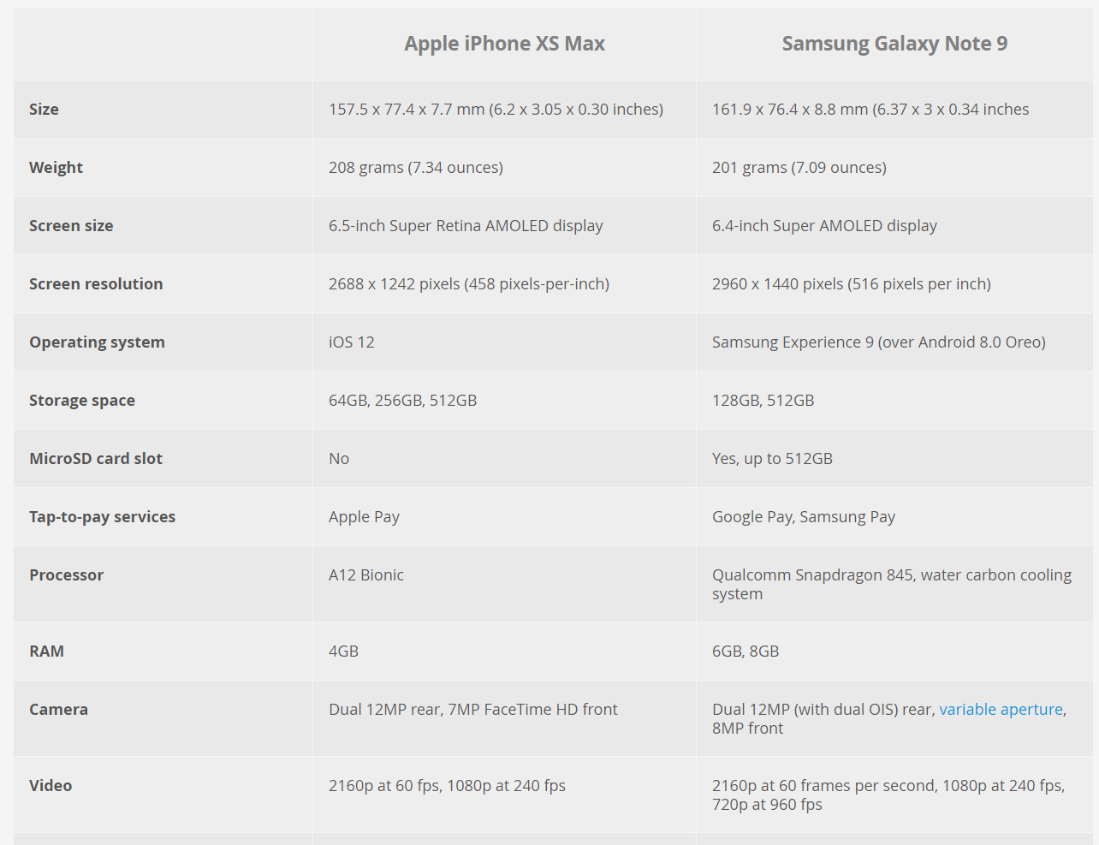
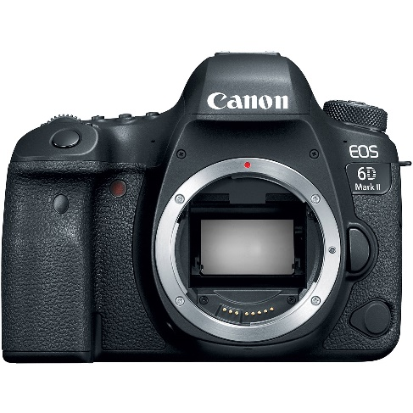
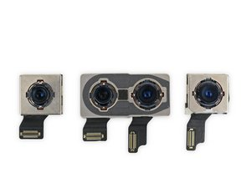
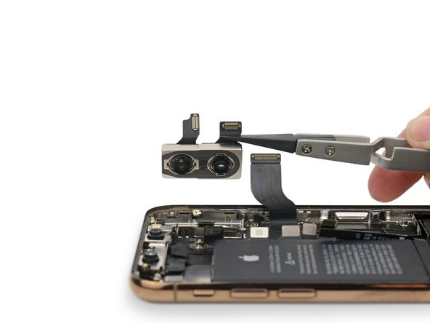
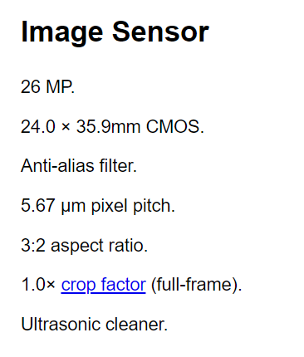
Example: Smart Phones
6D MK II
https://www.ifixit.com/Guide/Image/meta/JyuleQEJbHHs1BrU
https://kenrockwell.com/canon/6d-mk-ii.htm
Notes:
https://www.digitaltrends.com/mobile/apple-iphone-xs-max-vs-samsung-galaxy-note-9/

Slide 11
Questions
Case 1: Apple watch with a 4k screen.
Case 2: 80 inch high-definition full-HD TV.
Case 3: 4k monitor for Skype meeting
Case 4: 5 inch smart phone with 4k resolution for VR gaming
Case 5: 8K 80 inch TV for NETFLIX watching

Slide 12

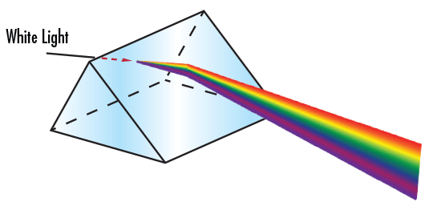
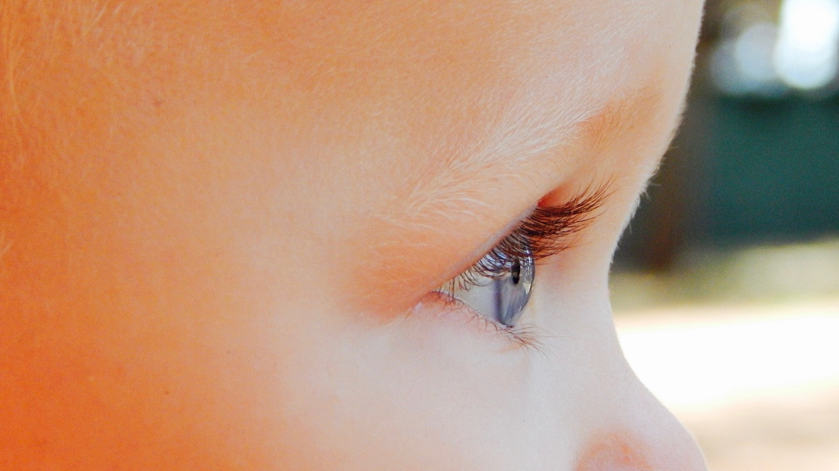
Role of Light to Sight
Rays from the sun reflect off plant and the green rays go in all directions
Notes:
https://www.pexels.com/photo/woman-leaning-on-glass-window-1101726/

Slide 13
Camera Sensor
digital sensor (CCD or CMOS)

Slide 14
Object We Like to Take
real-world object
digital sensor (CCD or CMOS)
What would an image taken like this look like?

Slide 15
Bare-sensor imaging
Bare-Sensor Imaging
real-world object
digital sensor (CCD or CMOS)

Slide 16
Light Reflect off All Positions on the Object and Goes in All Directions
real-world object
digital sensor (CCD or CMOS)

Slide 17
Light Reflect off All Points on the Object and Goes in All Directions
real-world object
digital sensor (CCD or CMOS)

Slide 18
What Does the Image on the Sensor Look Like?
real-world object
digital sensor (CCD or CMOS)
All scene points contribute to all sensor pixels

Slide 19
All Scene Points Contribute to All Sensor Pixels

Slide 20
What can We Do to Make Our Image Look Better?
real-world object
digital sensor (CCD or CMOS)

Slide 21
Pinhole Imaging
barrier (diaphragm)
pinhole (aperture)
real-world object
digital sensor (CCD or CMOS)
Very small pinhole

Slide 22
Pinhole Imaging
most rays are blocked
real-world object
digital sensor (CCD or CMOS)
one makes it through

Slide 23
Pinhole Imaging
most rays are blocked
real-world object
digital sensor (CCD or CMOS)
one makes it through

Slide 24
What Does the Image on the Sensor Look Like?
real-world object
digital sensor (CCD or CMOS)
Let’s assume that each scene point contributes to only one sensor pixel

Slide 25
Pinhole Imaging: the Object can be Captured !!
real-world object
copy of real-world object (inverted and scaled)

Slide 26
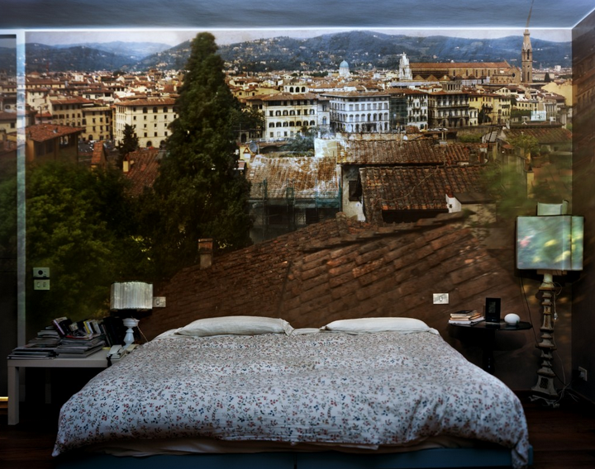
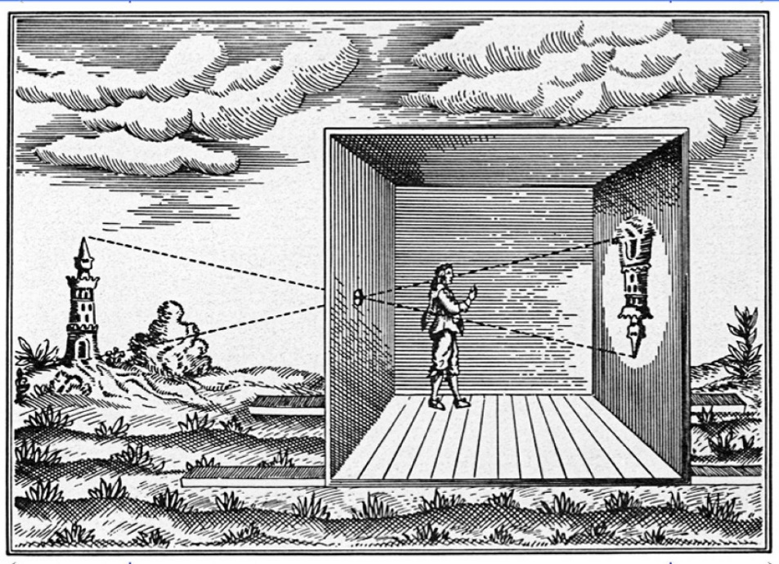
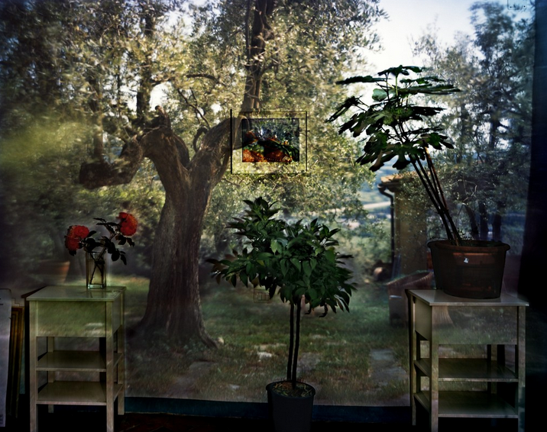
Camera Obscure
https://fstoppers.com/natural-light/camera-obscura-flips-outside-world-4971

Slide 27
Pinhole Camera Terms (Aperture)
barrier (diaphragm)
pinhole (aperture)
real-world object
digital sensor (CCD or CMOS)

Slide 28
Pinhole Camera Terms (Camera Center)
barrier (diaphragm)
image plane
pinhole (aperture)
real-world object
digital sensor (CCD or CMOS)
camera center (or optical center)

Slide 29
Pinhole Camera Terms (Focal Length)
real-world object
focal length f

Slide 30
What Happens as We Change the Focal Length?
real-world object
focal length 0.5 f

Slide 31
What Happens as We Change the Focal Length?
real-world object
focal length 0.5 f

Slide 32
What Happens as We Change the Focal Length?
real-world object
focal length 0.5 f
Which image has better quality?

Slide 33
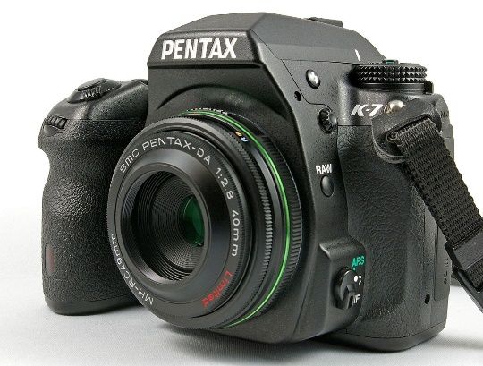
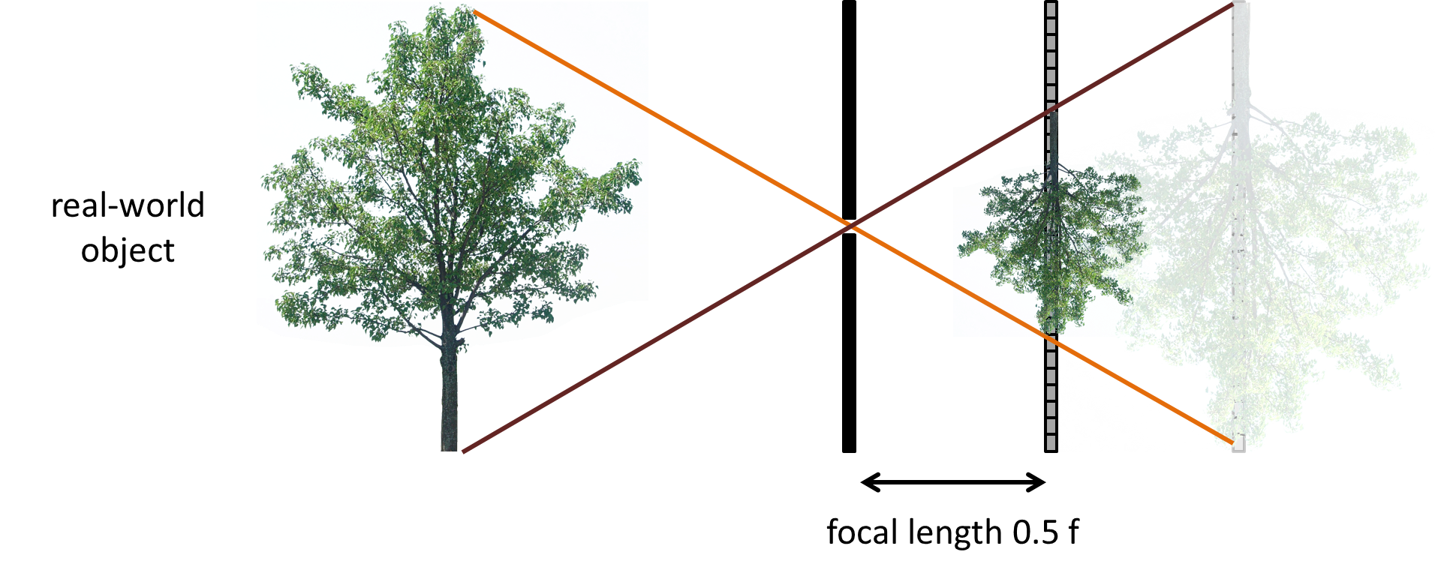
What Happens as We Change the Focal Length?
More scenes/objects can be included in the image
Zoom-in or Zoom-out

Slide 34
What Happens as We Change the Aperture Size?
real-world object
pinhole diameter
Ideal pinhole has infinitesimally small size
In practice that is impossible.

Slide 35
What Happens as We Change the Aperture Size?
real-world object
pinhole diameter

Slide 36
Pinhole size
What Happens as We Change the Aperture Size?
real-world object

Slide 37
Pinhole size
What Happens as We Change the Aperture Size?
real-world object

Slide 38
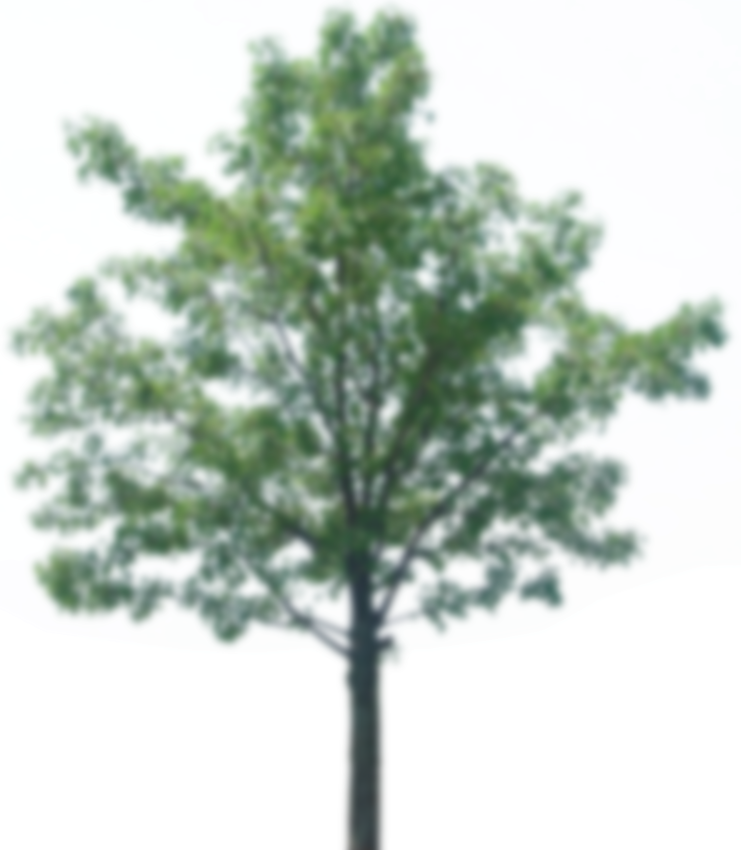
Pinhole size
What Happens as We Change the Aperture Size?
object projection becomes blurrier
real-world object
When do we open aperture?

Slide 39
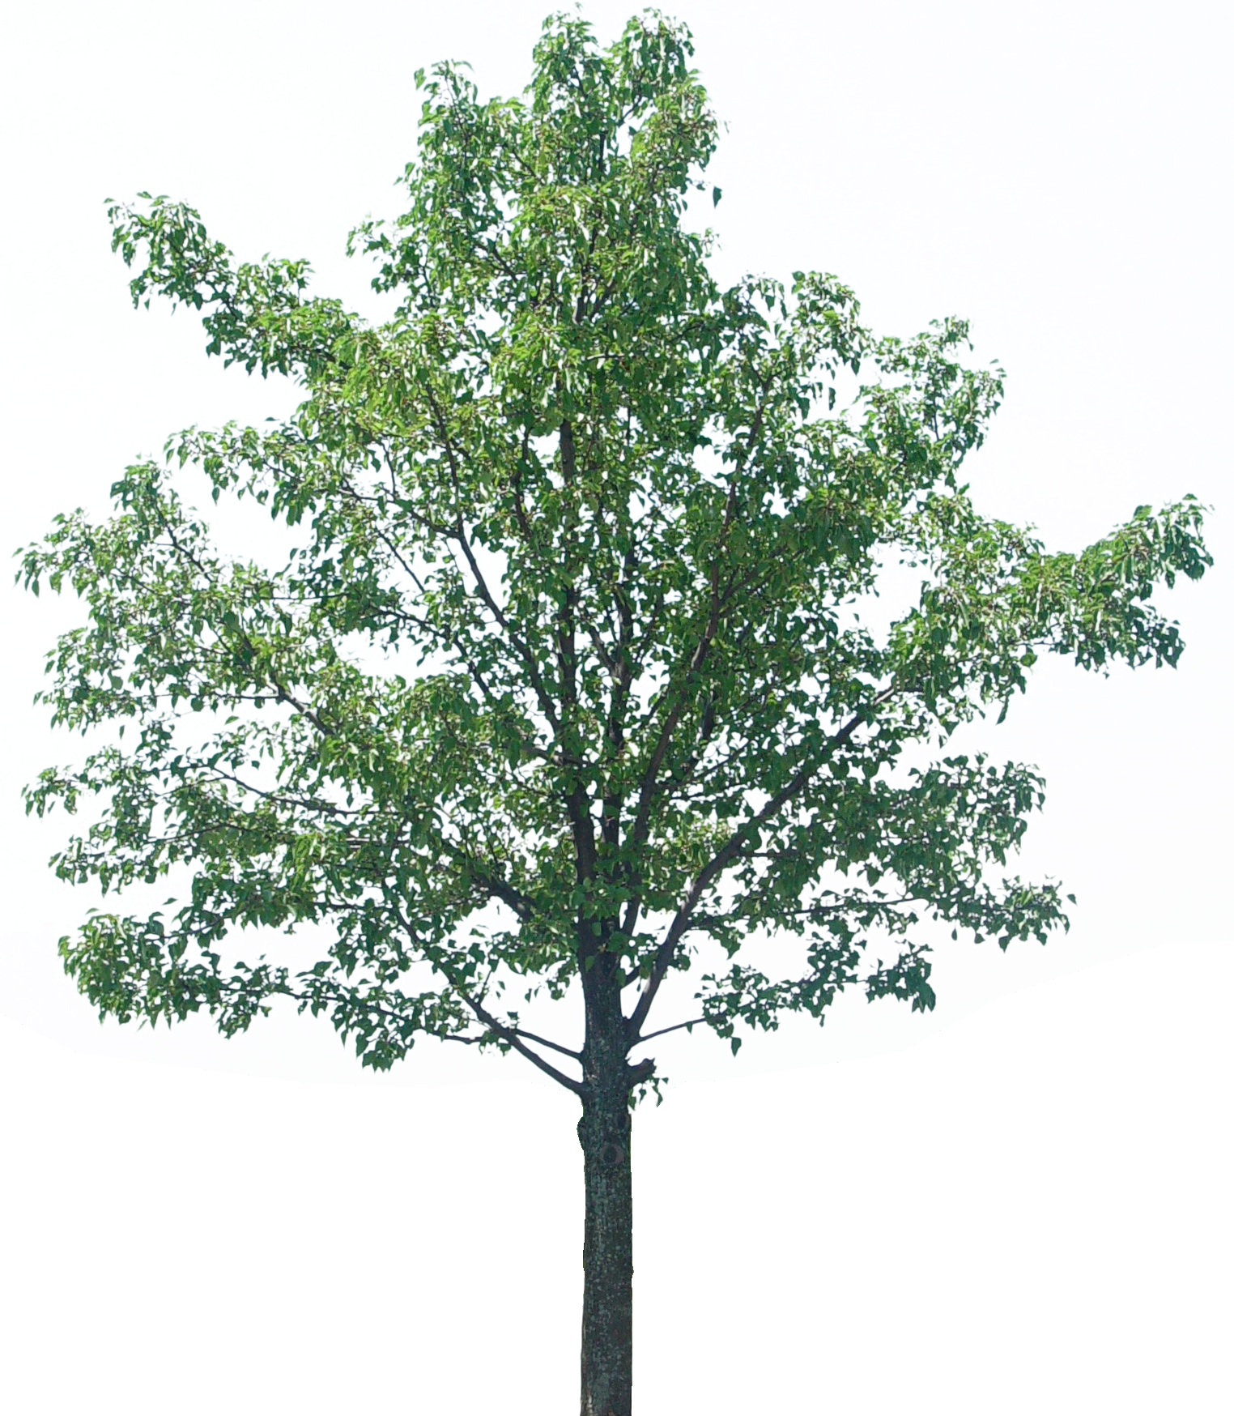
Will the Image Keep Getting Sharper the Smaller We Make the Pinhole?
real-world object
pinhole diameter

Slide 40
What about light efficiency?
Light Efficiency
real-world object
pinhole diameter
What is the effect of doubling the pinhole diameter?
What is the effect of doubling the focal length?
focal length f

Slide 41
Light Efficiency (Continue)
real-world object
pinhole diameter
2x pinhole diameter → 4x light
2x focal length → ¼x light
focal length f
2 x pinhole diameter and 2x focal length

Slide 42
F-Number or F-Stop
A “stop” is a change in camera settings that changes amount of light by a factor of 2
real-world object
pinhole diameter
focal length f
The “f-number” is the ratio: focal length / pinhole diameter

Slide 43
Thin lens model
Thin Lens Model
Simplification of geometric optics for well-designed lenses.
Two assumptions:
Rays passing through lens center are unaffected.

Slide 44
Thin lens model
Thin Lens Model (Continue)
Simplification of geometric optics for well-designed lenses.
focal length f
Two assumptions:
Rays passing through lens center are unaffected.
Parallel rays converge to a single point located on focal plane.

Slide 45
Replace the Pinhole with Lens
Lenses map “bundles” of rays from points on the scene to the sensor.
How does this mapping work exactly?

Slide 46
The lens camera
Difference Between Lens and Pinhole Cameras

Slide 47
Pinhole Camera
Central rays propagate in the same way for both models!

Slide 48
Focal Length in a Pinhole Camera
In a pinhole camera, focal length is distance between aperture and sensor
focal length f

Slide 49
Focal Length in a Lens Camera
In a lens camera, focal length is distance where parallel rays intersect
object distance D
focal length f
focus distance D’

Slide 50
Describing Both Les and Pinhole Cameras
We can derive properties and descriptions that hold for both camera models if:
We use only central rays.
We assume the lens camera is in focus.
We assume that the focus distance of the lens camera is equal to the focal length of the pinhole camera.

Slide 51
Understanding the Language of Photography
Aperture
Depth of field
Exposure
F-Number
ISO
RAW
Shutter speed
Flash
Shutter prior mode
Aperture prior mode
Tripod
Aspect Ratio
Focal length
Long exposure
https://www.creativelive.com/blog/common-photography-terms/
Notes:
https://www.toptenreviews.com/electronics/articles/basic-digital-slr-definitions/

Slide 52
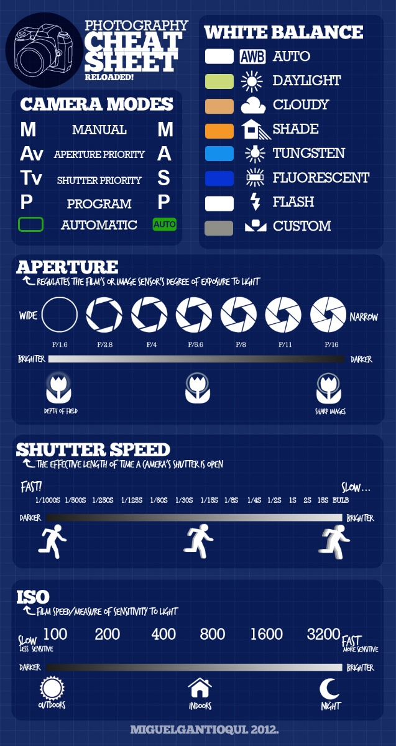
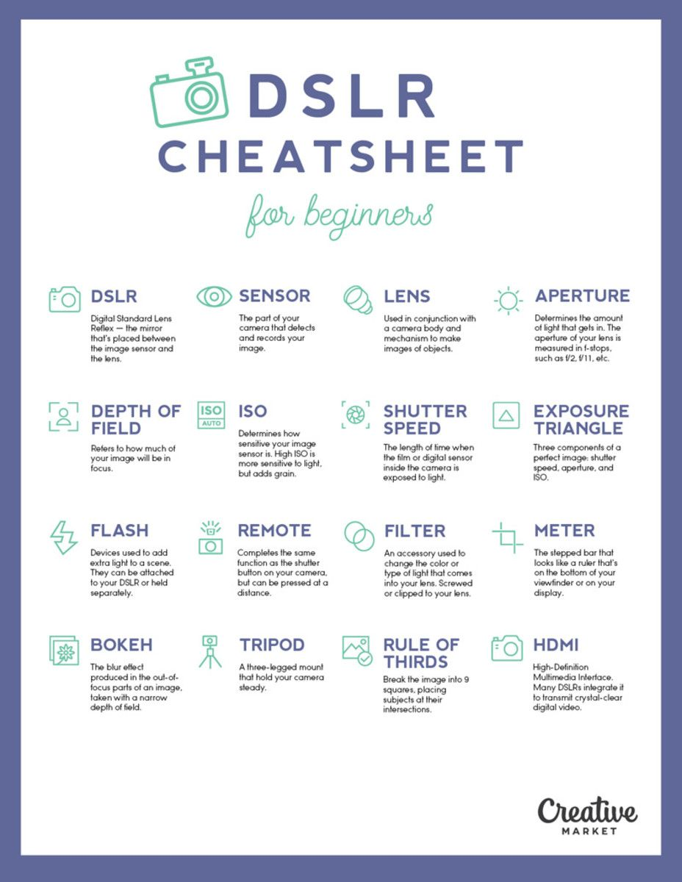
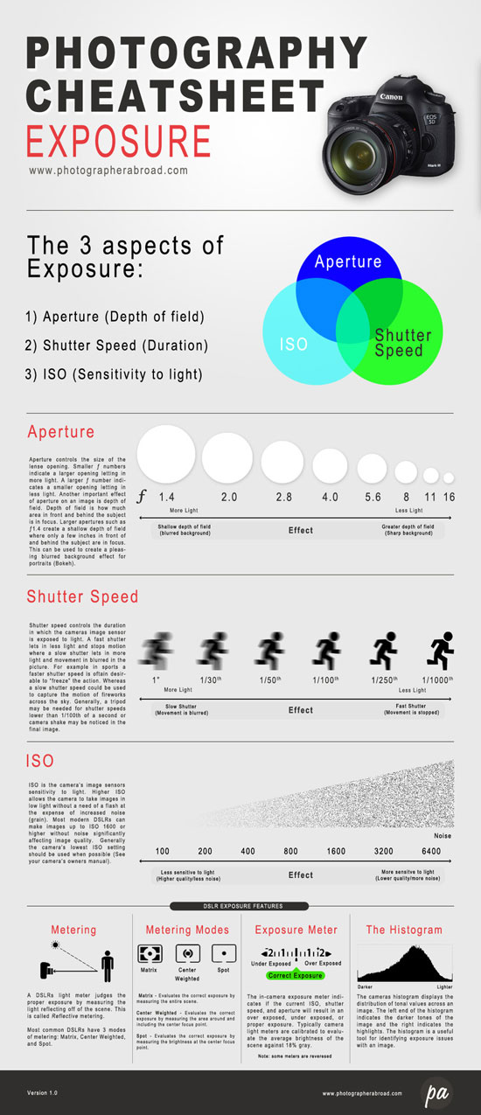
DSLR Cheat Sheet
Notes:
https://www.google.com/search?q=DSLR+Cheat+Sheet&num=50&newwindow=1&safe=off&rlz=1C1GCEA_enCA820CA820&source=lnms&tbm=isch&sa=X&ved=0ahUKEwjrxubdnJDgAhVB_oMKHToBAlcQ_AUIDigB&biw=2048&bih=1038#imgrc=JT92c7ZjrLhIlM:
https://www.google.com/search?q=DSLR+Cheat+Sheet&num=50&newwindow=1&safe=off&rlz=1C1GCEA_enCA820CA820&source=lnms&tbm=isch&sa=X&ved=0ahUKEwjrxubdnJDgAhVB_oMKHToBAlcQ_AUIDigB&biw=2048&bih=1038#imgrc=BbykZqPMO3w4aM:
https://www.google.com/search?q=DSLR+Cheat+Sheet&num=50&newwindow=1&safe=off&rlz=1C1GCEA_enCA820CA820&source=lnms&tbm=isch&sa=X&ved=0ahUKEwjrxubdnJDgAhVB_oMKHToBAlcQ_AUIDigB&biw=2048&bih=1038#imgrc=obI77yBKDKO3tM:

Slide 53
Why Do We Use a Tripod?
When taking night time shots and sunsets
When you need to be flexible
When you are taking close up shots
When you are taking action shots and doing sport photography
When you are doing natural photography
https://www.photographyblog.com/articles/7_reasons_why_you_should_use_a_tripod

Slide 54
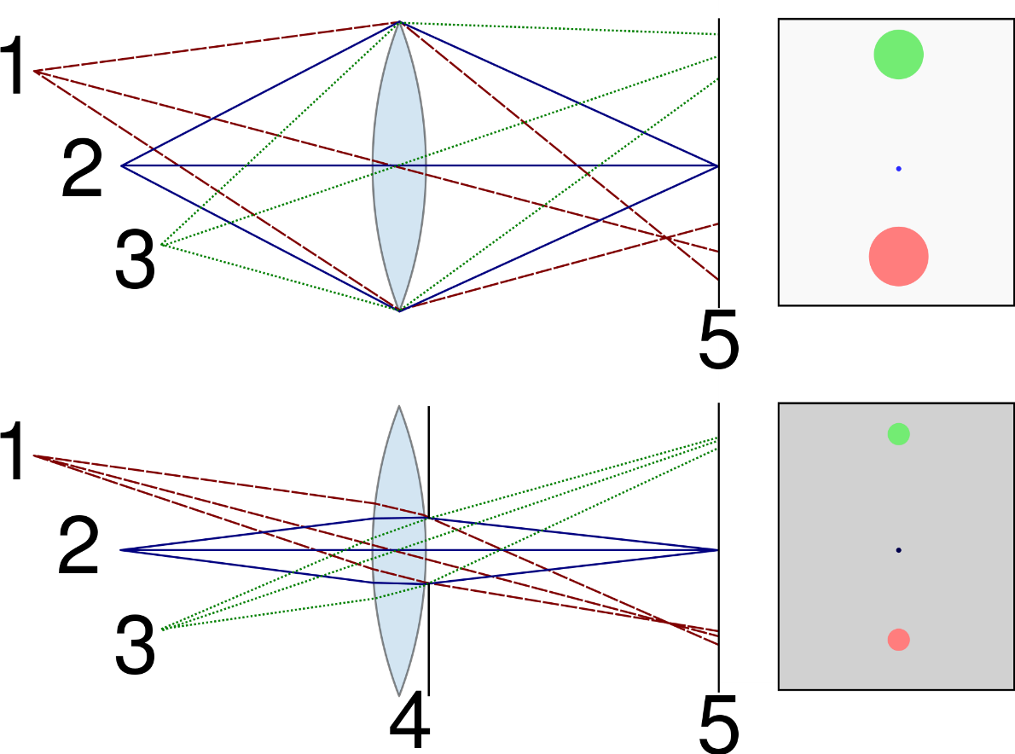
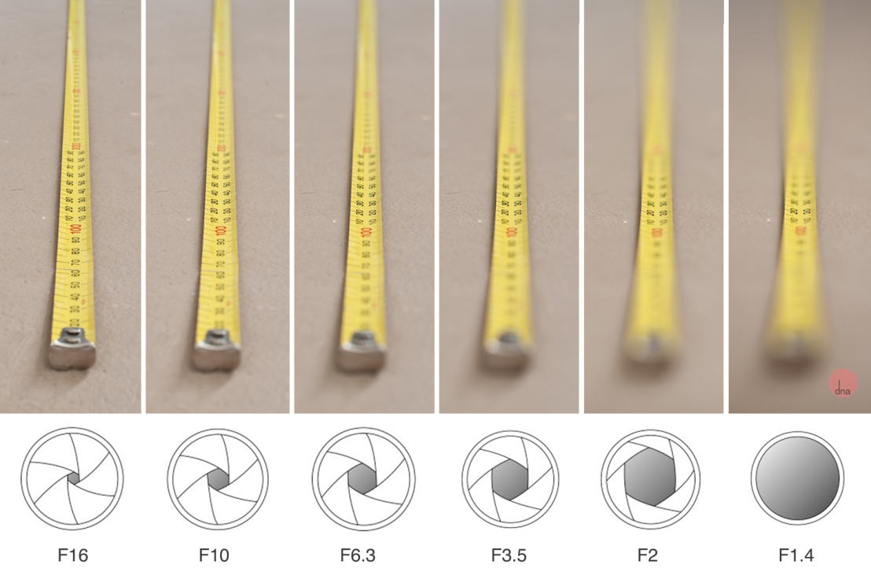
Effect of Aperture

Slide 55
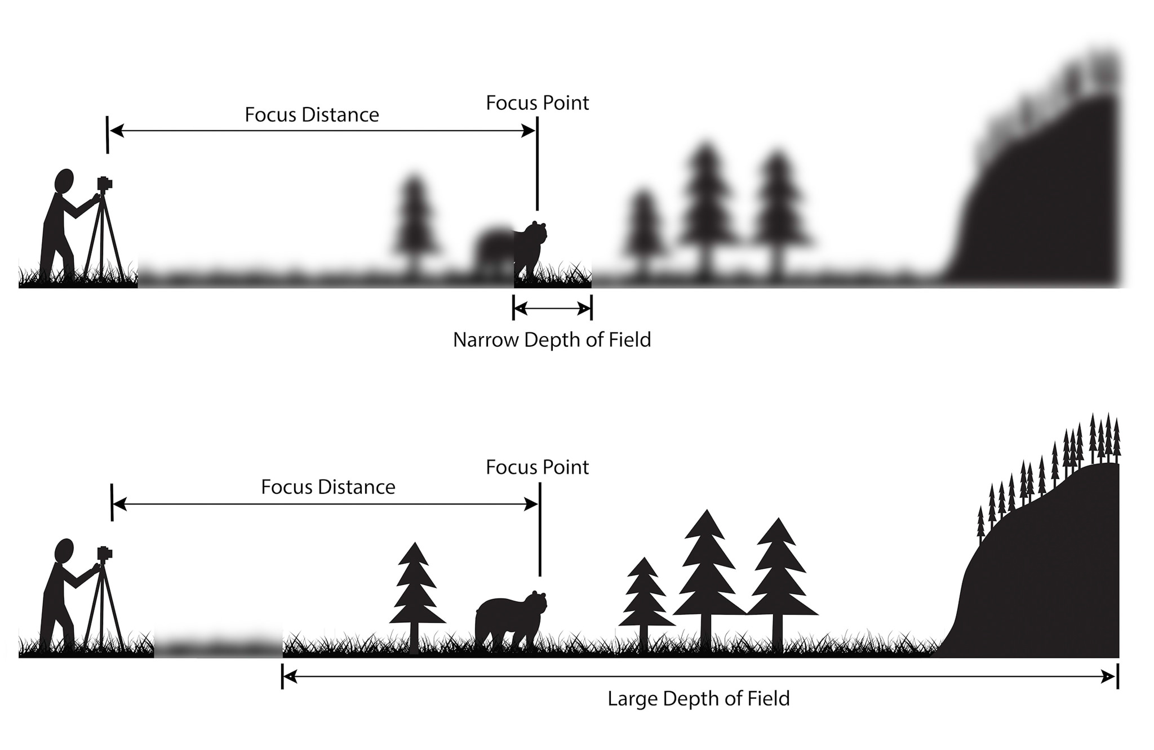
Understanding Depth of Field

Slide 56
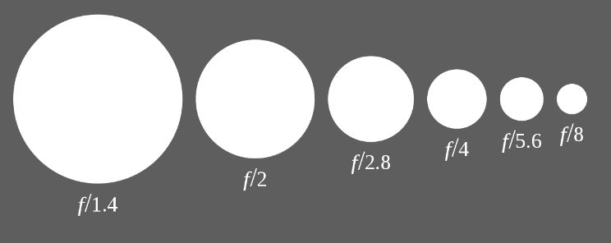
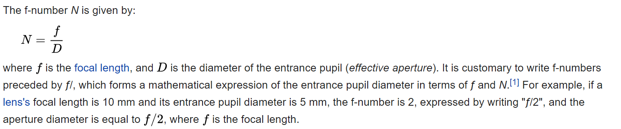
F-Number or F-Stop
The amount of light entering in the lens
Large f-number, Small aperture, Long focal length
Small f-number, Large aperture, Short focal length

Slide 57
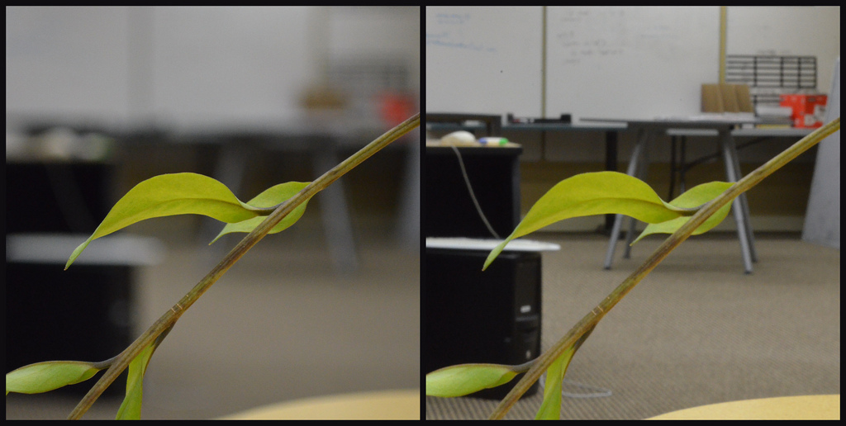
Different Depth of Fields
Why is it better?

Slide 58
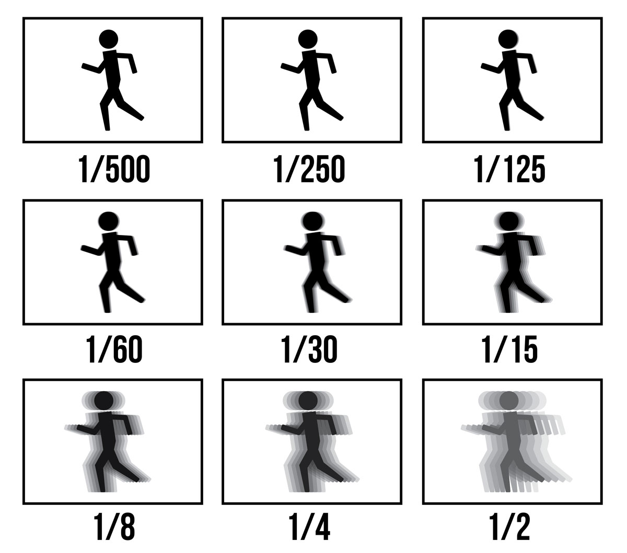
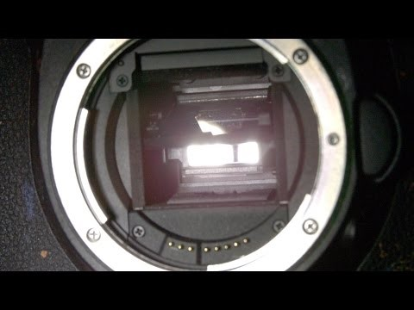
Effect of Shutter Speed
https://www.creativelive.com/photography-guides/what-is-shutter-speed

Slide 59
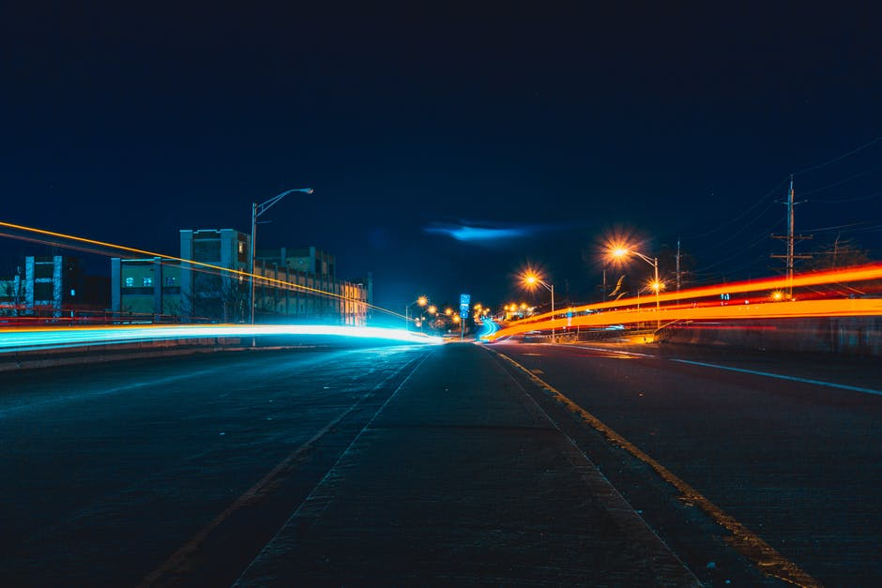
Example: Night Photography

Slide 60
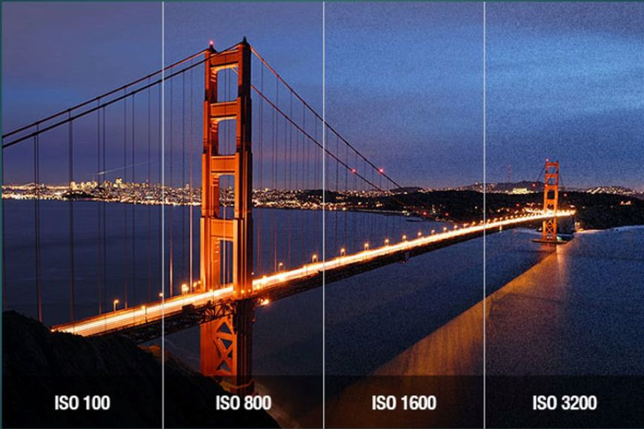
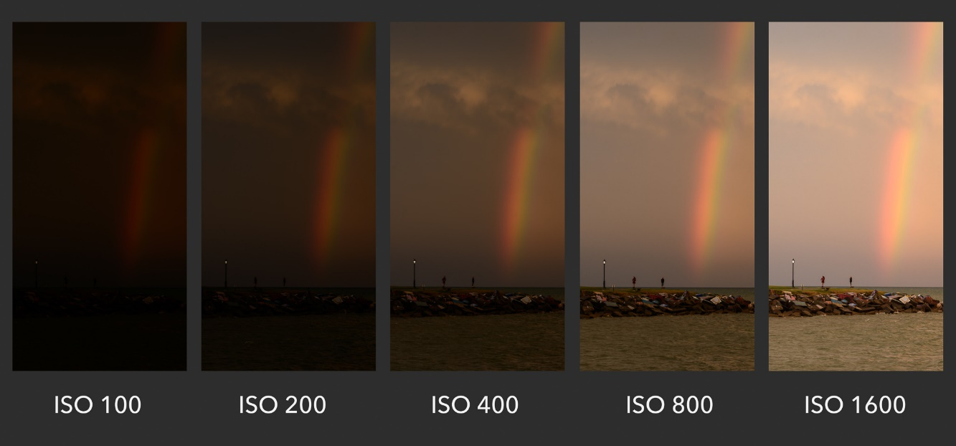
Effect of ISO
https://www.shawacademy.com/blog/everything-you-need-to-know-about-iso/
https://photographylife.com/what-is-iso-in-photography

Slide 61
Situations that Affects How You Choose an ISO
If your subject is moving and you’re trying freeze the motion for a still, a higher ISO will allow for a faster shutter speed.
If you’re using a tripod to stabilize your camera, you can usually get away with a slower shutter speed, which in turn allows you to use a lower ISO. Note that a tripod doesn’t help you freeze subject motion, however.
If you’re shooting an image that doesn’t require a large depth-of-field, you can increase the aperture (thus allowing more light into the lens) and use a lower ISO. Keep in mind that different lenses have different maximum aperture values, however, meaning not all lenses can let in the same amount of light.
If you’re shooting with artificial light — e.g., a flash — you can typically get away with a lower ISO setting.
If you plan to only show a small version of an image, such as on Instagram, you can get away with a higher ISO.
Subjectively, the noise characteristics of a high ISO setting can lend a vintage look to your photos, although this is an effect that is often better left for post-processing.
https://www.digitaltrends.com/photography/what-is-iso/

Slide 62
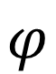
Field of view
also known as angle of view
$$φ$$
Note: here I drew a lens, but I could have just as well drawn a pinhole

Slide 63
Field of view
Field of View (Continue)
move sensor to keep focus at same distance
change in focal length
Note: “zooming” means changing focal length, which is different from refocusing
What happens to field of view when we focus closer? → It decreases.
What happens to field of view when we increase lens focal length? → It decreases.

Slide 64
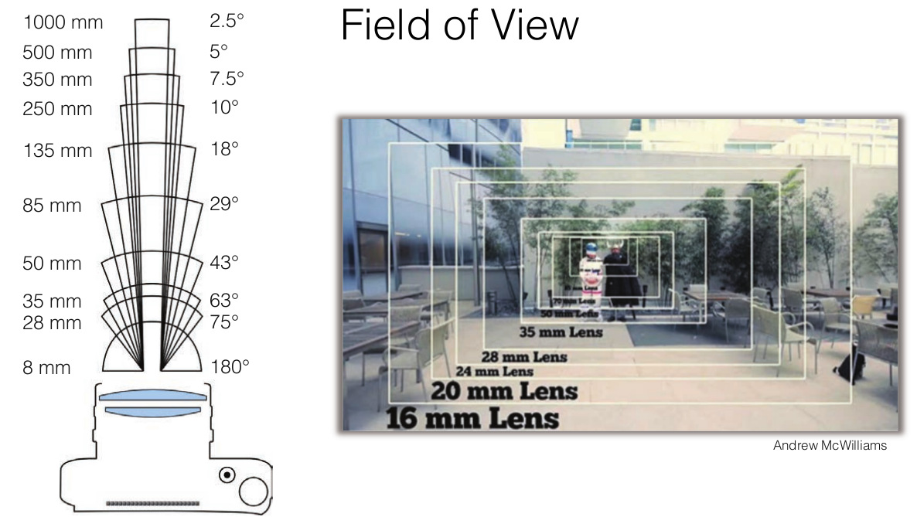
Field of view
Field of View (Continue)

Slide 65
Field of View Depending on Sensor Size
What happens to field of view when we reduce sensor size?

Slide 66
Field of View Depending on Sensor Size
change in focal length
What happens to field of view when we reduce sensor size? → It decreases.

Slide 67
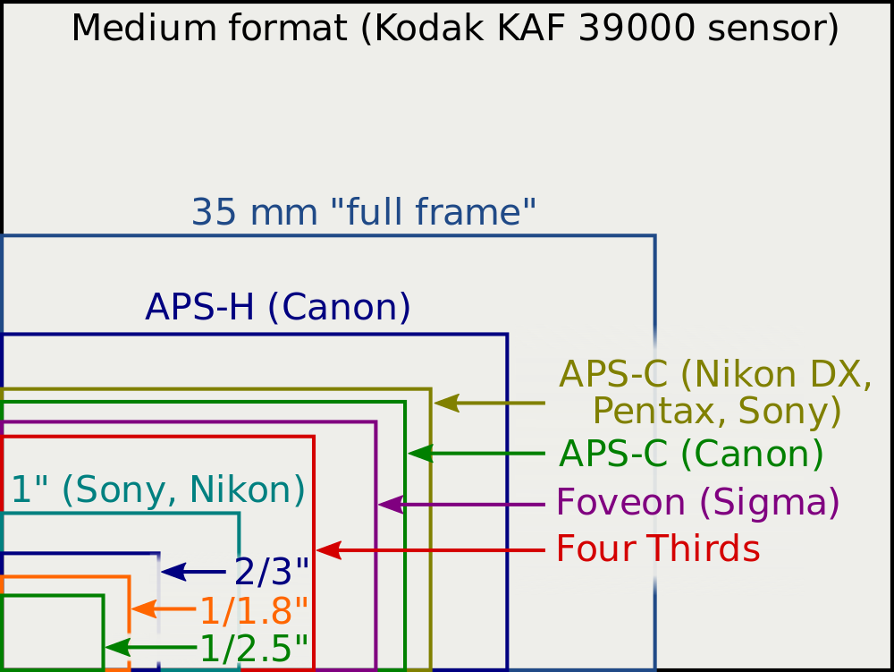
Field of View Depending on Sensor Size
“Full frame” corresponds to standard film size.
Digital sensors come in smaller formats due to manufacturing limitations (now mostly overcome).
Lenses are often described in terms of field of view on film instead of focal length.
These descriptions are invalid when not using full-frame sensor.

Slide 68
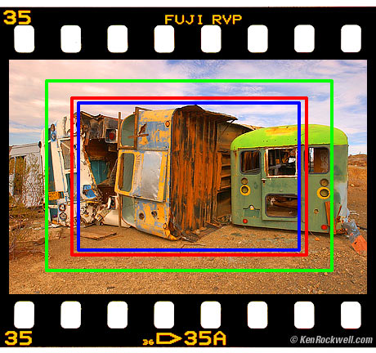
Field of View Depending on Sensor Size
How much field of view is cropped when using a sensor smaller than full frame.

Slide 69
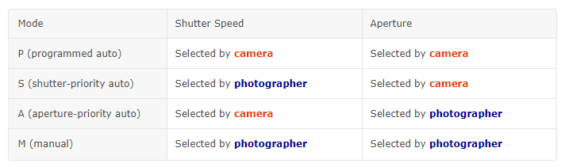
DSLR Camera (Shutter Priority vs Aperture Priority Modes)
Mode P (Programmed Auto)
The camera automatically adjusts aperture and shutter speed for optimal exposure, but the photographer can choose from different combinations of aperture and shutter speed that will produce the same exposure. This is known as flexible program.
Mode S (Shutter-Priority Auto)
The photographer chooses the shutter speed and the camera automatically adjusts aperture for optimal exposure.
Mode A (Aperture-Priority Auto)
The photographer chooses the aperture and the camera automatically adjusts shutter speed for optimal exposure.
https://imaging.nikon.com/lineup/dslr/basics/04/06.htm

Slide 70
Question
Quantization
Clipping
Aliasing
Oversampling

Slide 71
Slide Credits
Lecture notes: Rob Fergus.
Lecture notes: Steve Seitz
Lecture notes: Mohammad Jahanshahi
Lecture notes: Svetlana Lazebnik
Lecture notes: Derek Hoiem
Lecture notes: Ioannis (Yannis) Gkioulekas
Lecture notes: Kris Kitani
Lecture notes: Fredo Durand
Lecture notes: Gordon Wetzstein

Slide 72
Camera Rent
https://doodle.com/poll/x2aqnk3f92yighm9

Slide 73
Diffraction limit
Diffraction Limit
A consequence of the wave nature of light

Slide 74
Diffraction limit
Diffraction Limit
A consequence of the wave nature of light

Slide 75


Diffraction limit
Diffraction Limit
Large aperture
Small aperture
Notes:
https://www.cambridgeincolour.com/tutorials/diffraction-photography.htm

Slide 76


Effect of the Diffraction Pattern
Diffraction pattern
Airy disk
Airy disk in 3D

Slide 77




Effect of the Diffraction Pattern
Barley resolved
No longer resolved

